Slide 1
Causal Inference Crash Course Part 4: Best Practices: Outliers, Class Imbalance, Feature Selection, and Bad Control
Julian Hsu

Slide 2
Causal Inference Series
Foundations
Defining Some ATE/ATET Causal Models
ATE/ATET Inference, Asymptotic Theory, and Bootstrapping
Best Practices: Outliers, Feature Selection, Bad Control, and Propensity Trimming
Heterogeneous Treatment Effect Models and Inference
Difference-in-Difference Models for Panel Data
Regression Discontinuity Models
Arguable Validation

Slide 3
Overview
This presentation will outline best practices for issues around causal inference which can be applied to other ML settings.
Outliers;
Feature Selection;
Bad Control ; and
Propensity Score Trimming
For each issue, we will discuss what the problem is, why it’s a problem, and a solution outline.

Slide 4
A. Outliers

Slide 5
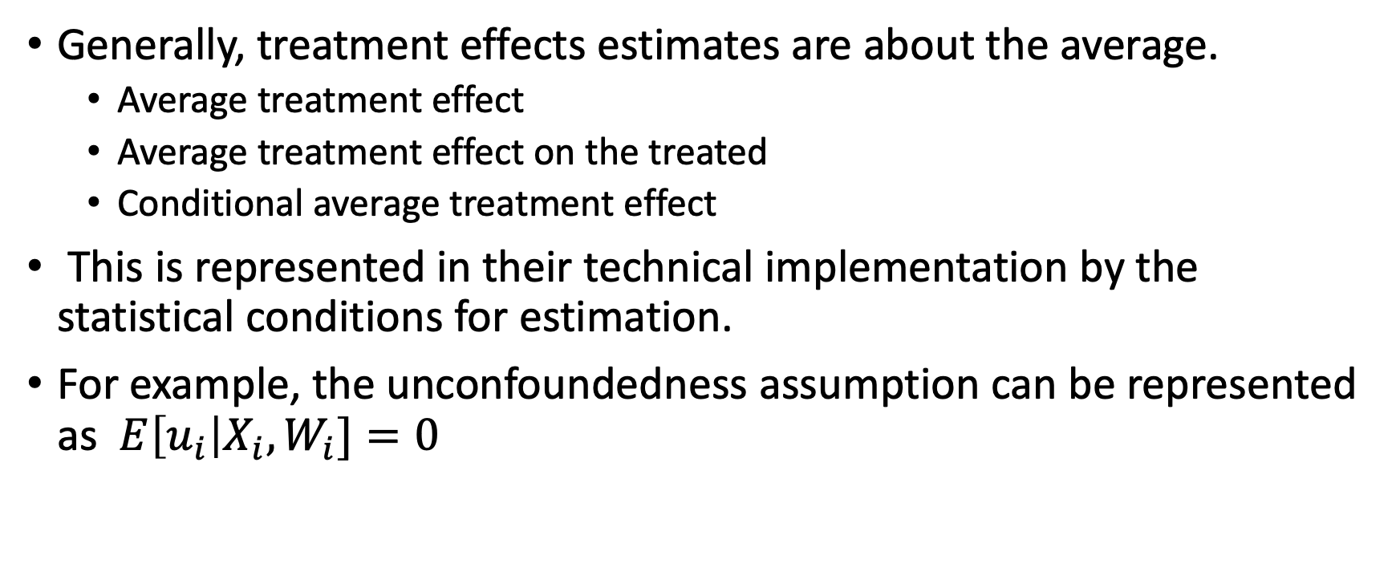
Why are outliers problems?
Generally, treatment effects estimates are about the average.
Average treatment effect
Average treatment effect on the treated
Conditional average treatment effect
This is represented in their technical implementation by the statistical conditions for estimation.
For example, the unconfoundedness assumption can be represented as $E\left[u_{i}\right|X_{i}, W_{i}]=0$

Slide 6
Outliers skew the average
Obviously, outlier values cause the average to take on extreme values
This is also a theoretical problem because we have already decided our metric of interest is the average. The average by its nature is sensitive to outliers.
The median not so much, but we’ll return to the median later.
Outliers can be a problem if the data is is meant to be representative, but we still have low sample size.

Slide 7
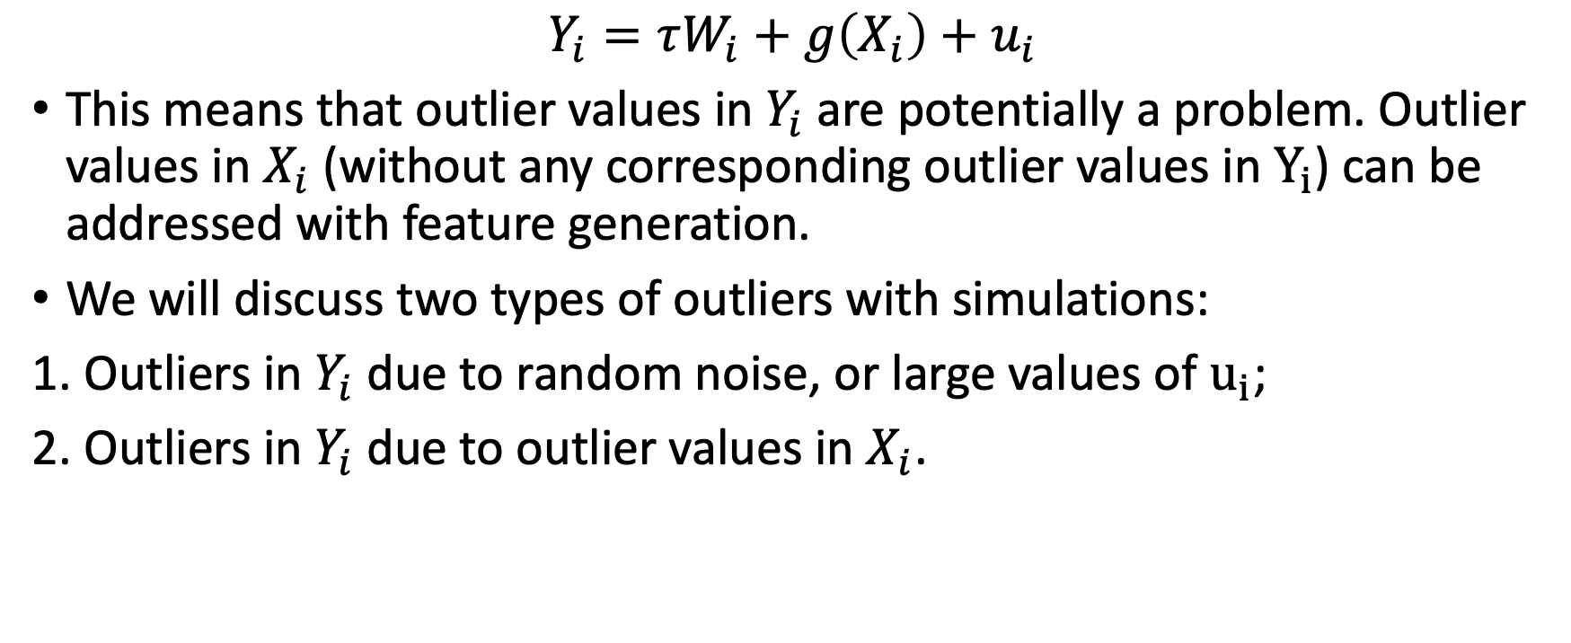
Two types of outliers
$$Y_{i}=τW_{i}+g\left(X_{i}\right)+u_{i}$$
This means that outlier values in $Y_{i}$are potentially a problem. Outlier values in $X_{i}$ (without any corresponding outlier values in $Y_{i}$) can be addressed with feature generation.
We will discuss two types of outliers with simulations:
1. Outliers in $Y_{i}$ due to random noise, or large values of $u_{i}$;
2. Outliers in $Y_{i}$ due to outlier values in $X_{i}$.

Slide 8
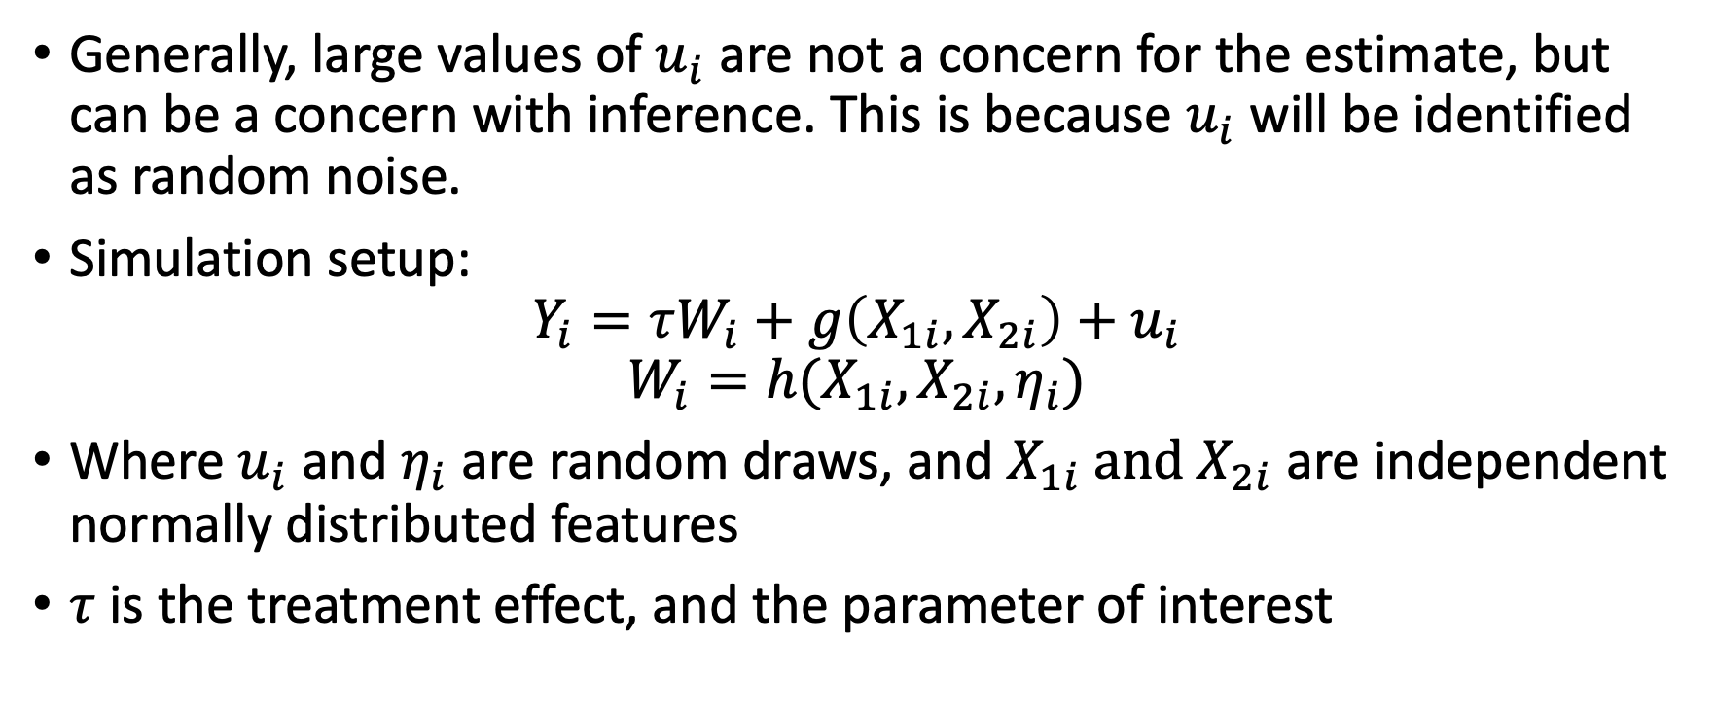
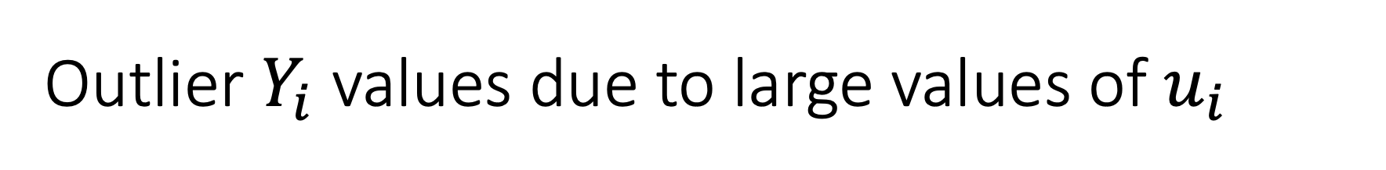
Outlier $Y_{i}$ values due to large values of $u_{i}$
Generally, large values of $u_{i}$ are not a concern for the estimate, but can be a concern with inference. This is because $u_{i}$ will be identified as random noise.
Simulation setup:
$$Y_{i}=τW_{i}+g\left(X_{1i},X_{2i}\right)+u_{i}$$
$$W_{i}=h(X_{1i}, X_{2i}, η_{i})$$
Where $u_{i}$ and$η_{i}$ are random draws, and $X_{1i} \text{and} X_{2i}$ are independent normally distributed features
$τ$ is the treatment effect, and the parameter of interest

Slide 9
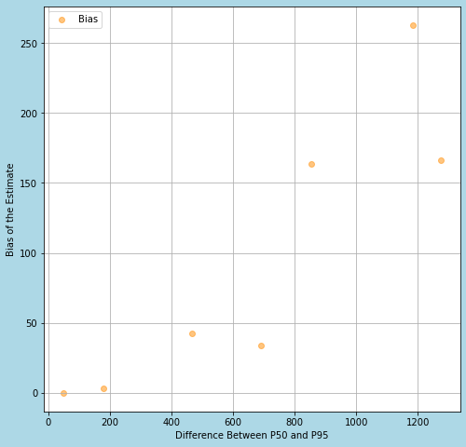
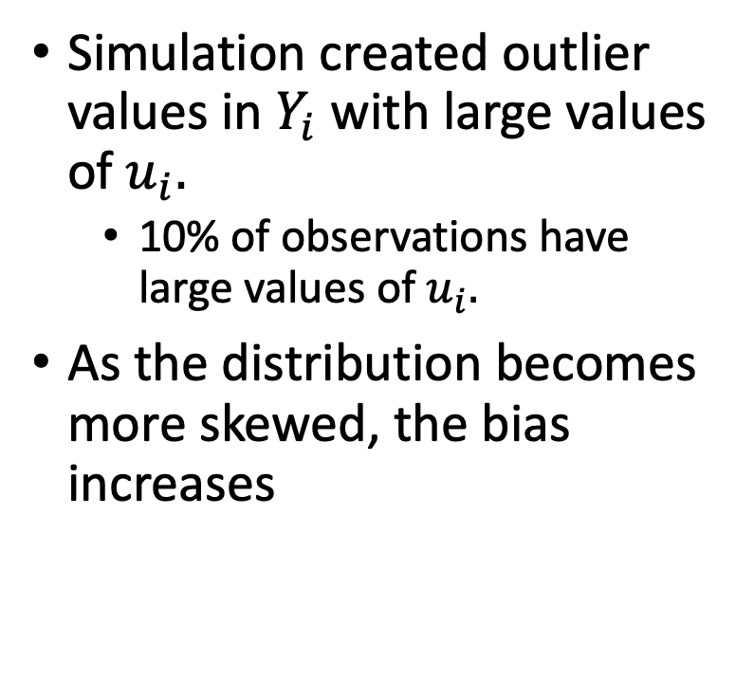
Simulation evidence
Simulation created outlier values in $Y_{i}$ with large values of $u_{i}.$
10% of observations have large values of $u_{i}.$
As the distribution becomes more skewed, the bias increases

Slide 10
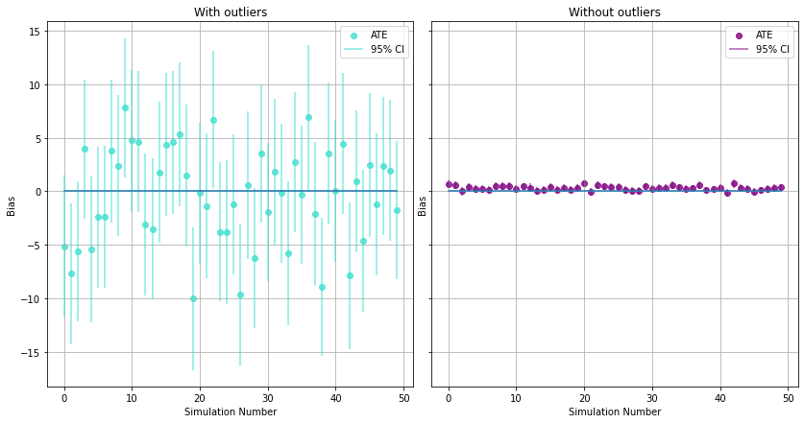
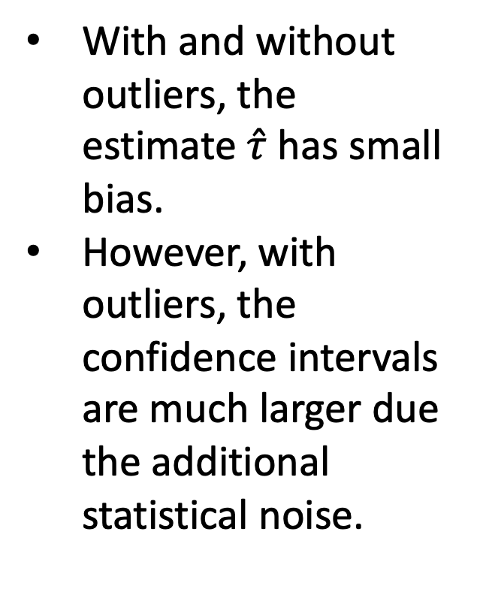
Simulation results on the bias
With and without outliers, the estimate $\hat{τ}$ has small bias.
However, with outliers, the confidence intervals are much larger due the additional statistical noise.

Slide 11
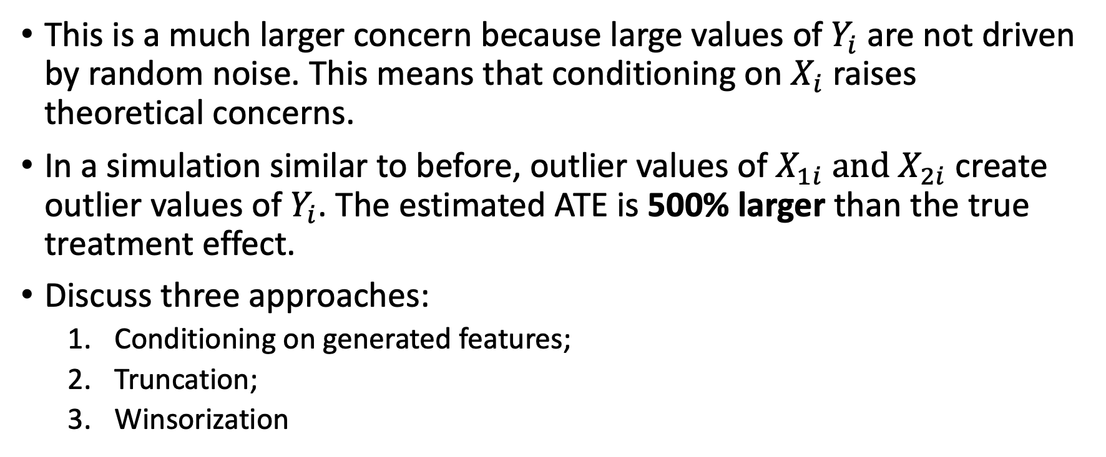
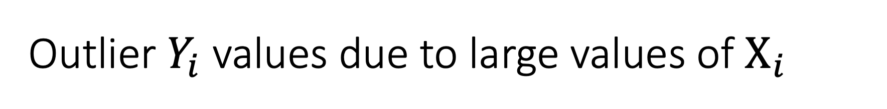
Outlier $Y_{i}$ values due to large values of $X_{i}$
This is a much larger concern because large values of $Y_{i}$ are not driven by random noise. This means that conditioning on $X_{i}$raises theoretical concerns.
In a simulation similar to before, outlier values of $X_{1i} \text{and} X_{2i}$ create outlier values of $Y_{i}$. The estimated ATE is 500% larger than the true treatment effect.
Discuss three approaches:
Conditioning on generated features;
Truncation;
Winsorization

Slide 12
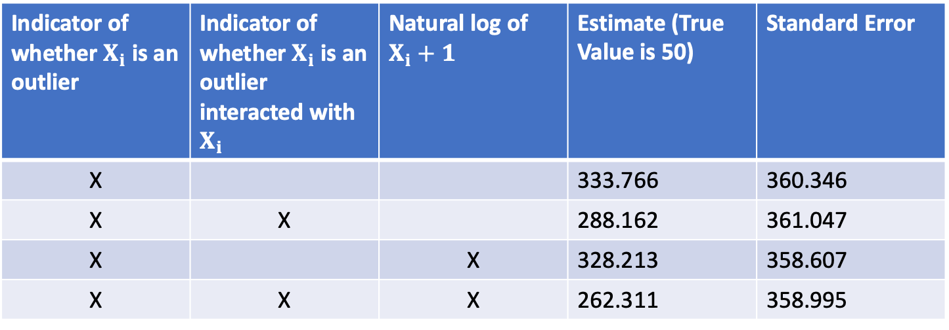
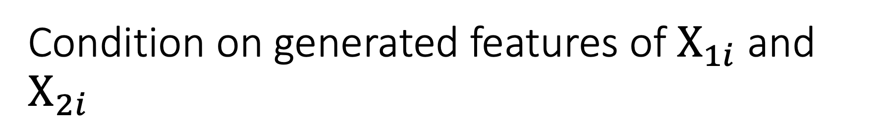
Condition on generated features of $X_{1i}$ and $X_{2i}$
Indicator of whether $X_{i}$ is an outlier | Indicator of whether $X_{i}$ is an outlier interacted with $X_{i}$ | Natural log of $X_{i}+1$ | Estimate (True Value is 50) | Standard Error
X |  |  | 333.766 | 360.346
X | X |  | 288.162 | 361.047
X |  | X | 328.213 | 358.607
X | X | X | 262.311 | 358.995
Conditioning on additional features drives the estimate to be closer to the truth, but at best the estimate is more than 400% larger
There is also no impact on the standard error

Slide 13

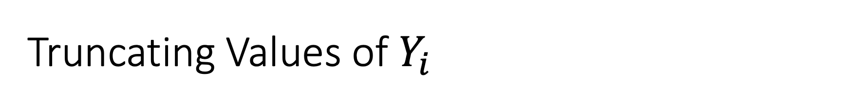
Truncating Values of $Y_{i}$
Truncation is removing observations based on values of $Y_{i}$ .
However, it is unclear how much to truncate. The more data is truncated, the less natural variation in the data is removed.
No principled way to determine the best truncation point.

Slide 14
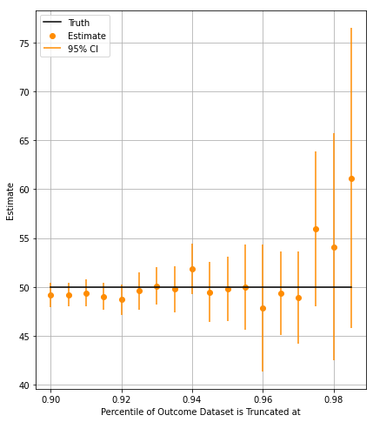
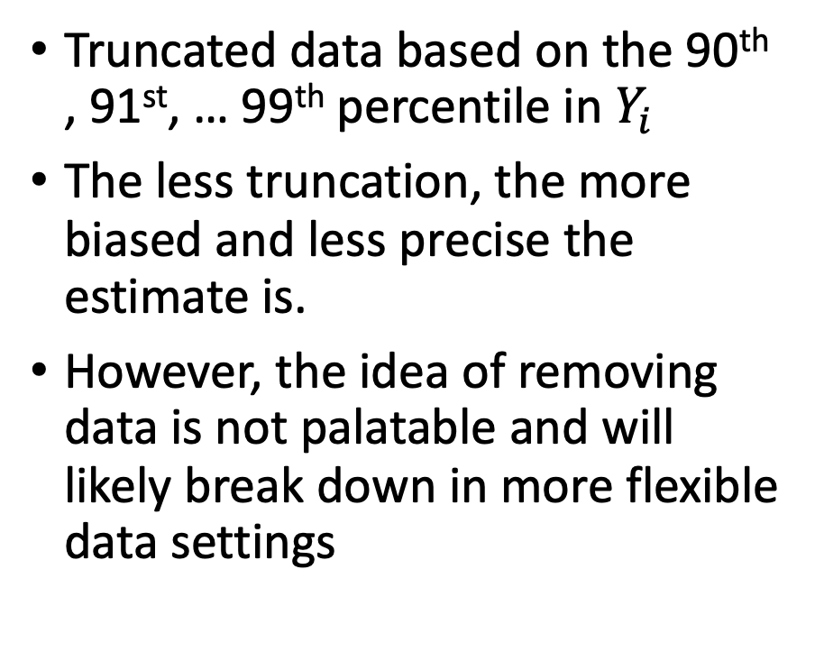
Truncation simulation evidence
Truncated data based on the 90th , 91st, … 99th percentile in $Y_{i}$
The less truncation, the more biased and less precise the estimate is.
However, the idea of removing data is not palatable and will likely break down in more flexible data settings

Slide 15
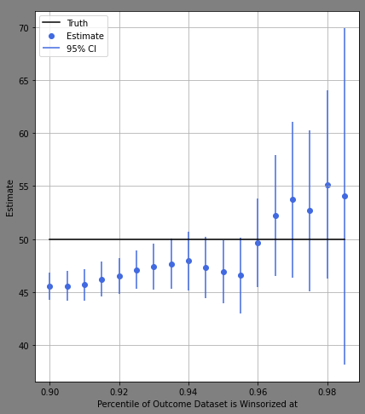
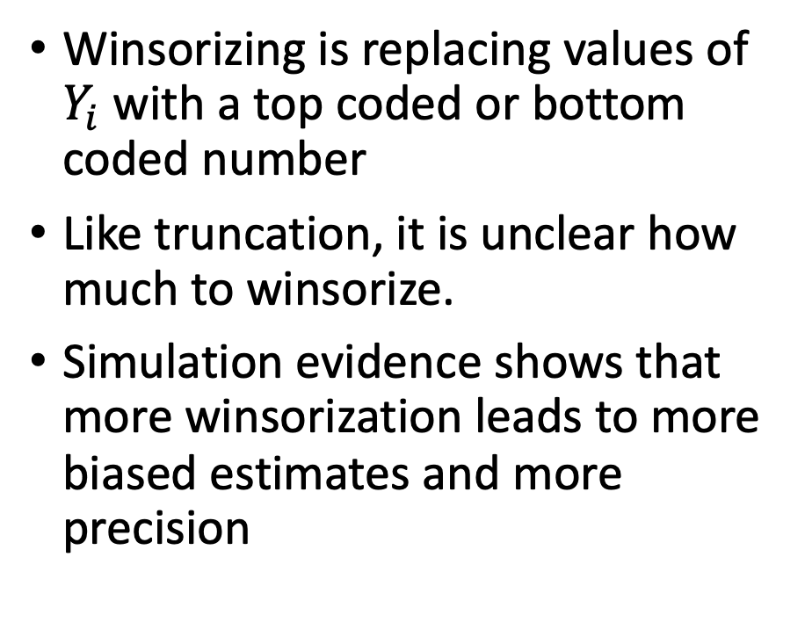
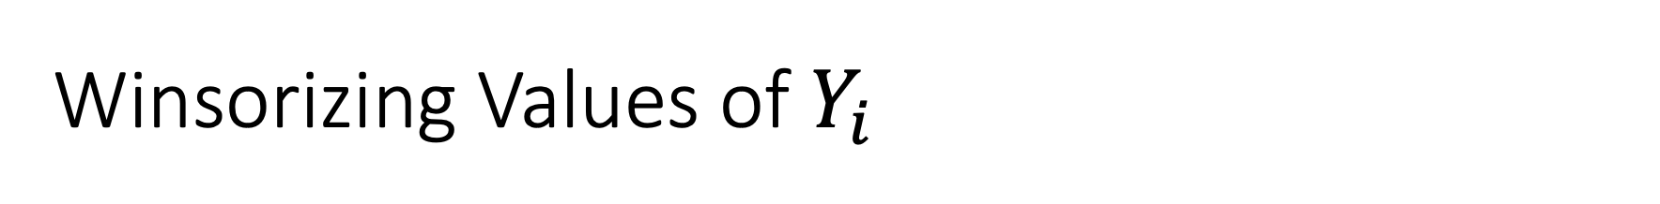
Winsorizing Values of $Y_{i}$
Winsorizing is replacing values of $Y_{i}$ with a top coded or bottom coded number
Like truncation, it is unclear how much to winsorize.
Simulation evidence shows that more winsorization leads to more biased estimates and more precision

Slide 16
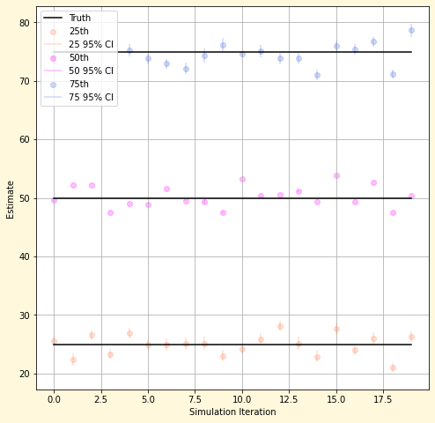
WIP – Median and Quantile Treatment Effects

Slide 17
B. Feature Selection
WIP

Slide 19
C. Bad Control
WIP

Slide 21
D. Propensity Score Trimming
WIP

Slide 22
Weighting in propensity-based causal models
Propensity-based causal models such as IPW and DML are all identified with the same assumptions (overlap, exogeneity, and stable unit treatment variable assumption).
At a high level, they all estimate treatment effects by comparing control and treatment accounts with similar propensity scores, that are, in other words, similarly likely to be treated.
We show that extremely large and small propensity scores can raise issues.
We show how propensity weighting happens in IPW and DML estimators.

Slide 23
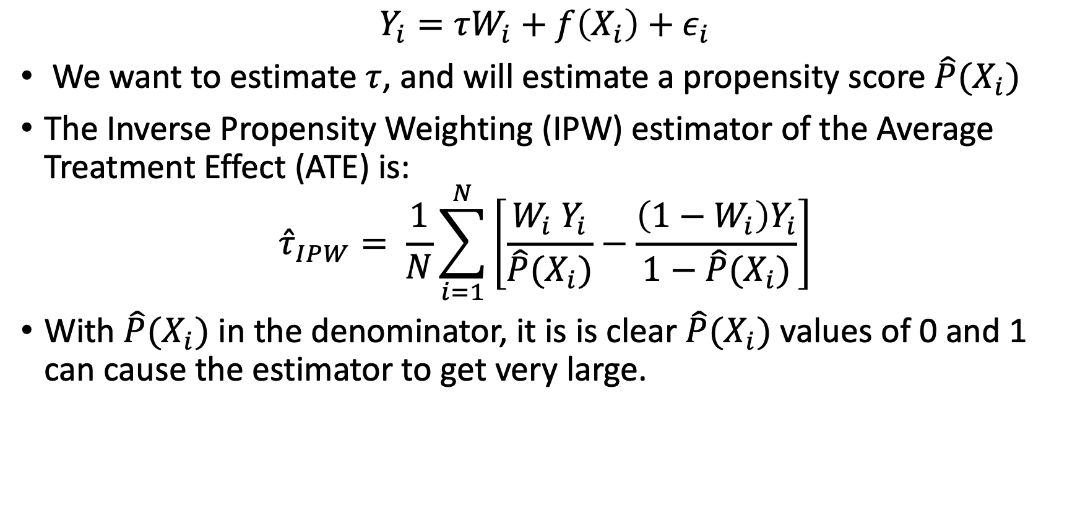
Weighting in IPW
$$Y_{i}=τW_{i}+f\left(X_{i}\right)+ε_{i}$$
We want to estimate $τ$, and will estimate a propensity score $\hat{P}(X_{i})$
The Inverse Propensity Weighting (IPW) estimator of the Average Treatment Effect (ATE) is:
$${\hat{τ}}_{IPW}= \frac{1}{N}\sum_{i=1}^{N}{\left[\frac{W_{i} Y_{i}}{\hat{P}(X_{i})}−\frac{\left(1−W_{i}\right)Y_{i}}{1−\hat{P}(X_{i})}\right]}$$
With $\hat{P}(X_{i})$ in the denominator, it is is clear $\hat{P}(X_{i})$ values of 0 and 1 can cause the estimator to get very large.

Slide 24
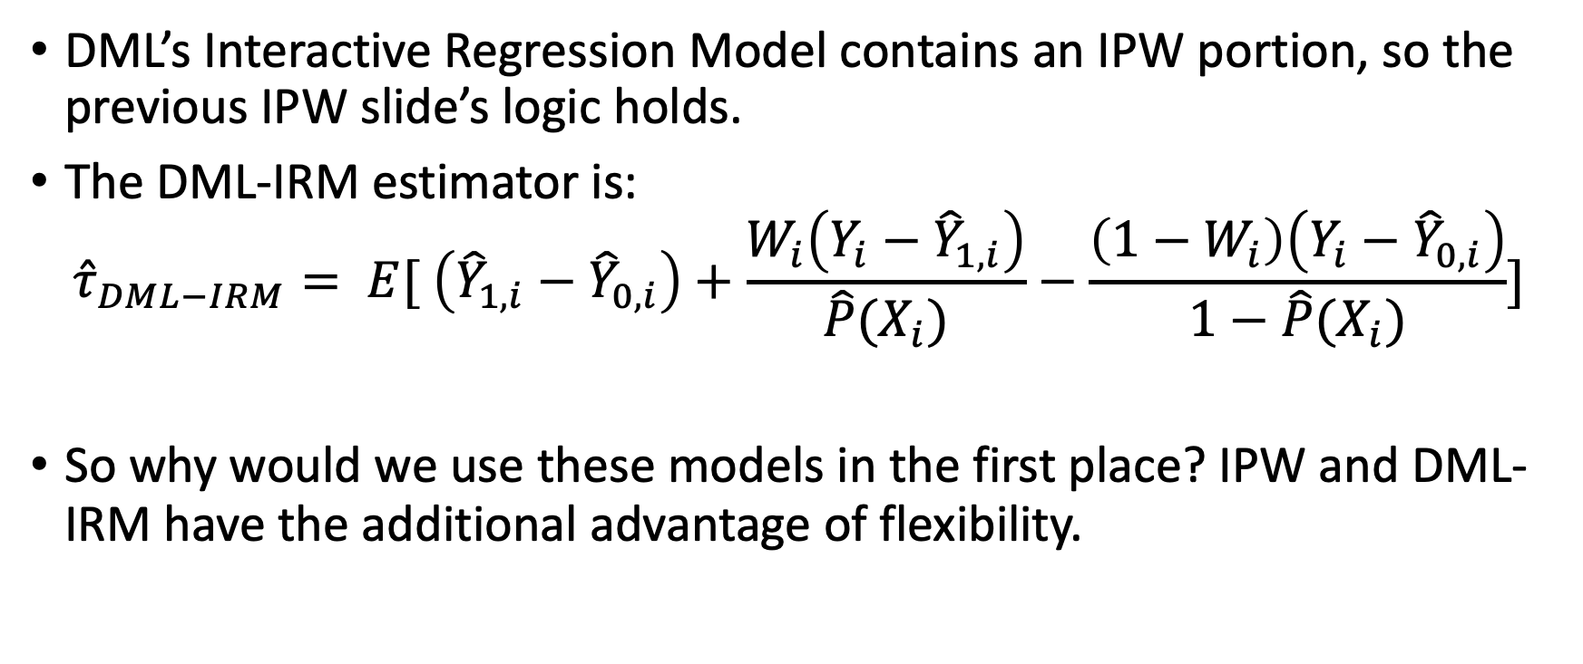
Weighting in DML
DML’s Interactive Regression Model contains an IPW portion, so the previous IPW slide’s logic holds.
The DML-IRM estimator is:
$${\hat{τ}}_{DML−IRM}= E[ \left({\hat{Y}}_{1,i}−{\hat{Y}}_{0,i}\right)+\frac{W_{i}\left(Y_{i}−{\hat{Y}}_{1,i}\right)}{\hat{P}(X_{i})}−\frac{\left(1−W_{i}\right)\left(Y_{i}−{\hat{Y}}_{0,i}\right)}{1−\hat{P}(X_{i})}]$$
So why would we use these models in the first place? IPW and DML-IRM have the additional advantage of flexibility.

Slide 25
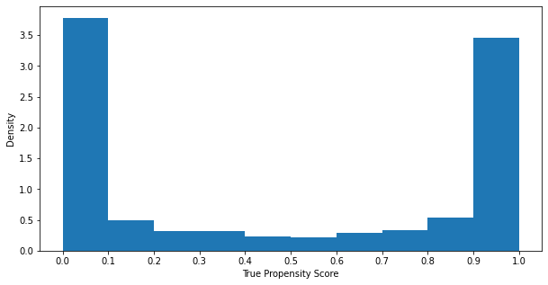
Simulation case
Distribution of True Propensity Scores
Setup where we have extremely large and small propensity scores
Estimate the average treatment effect (ATE) with IPW and DML-IRM models.

Slide 26
Possible Approaches
Replace extremely large/small propensity scores with a:
bin average; or
Sample average.
Remove observations with large/small propensity scores.
The challenge is that these approaches will create bias in the estimate, so how do you know whether you have eliminated the bias?

Slide 27
Robustness to approaches
If a placebo outcome is available, where you know the true treatment effect is zero, then you can tune your approach to the placebo outcome.
If not, then you have to balance the bias and variance of the approach. Specifically, the more generous your adjustment the more bias but smaller the variance you have.

Slide 29
Simulation of bias-variance trade-offs

Slide 30
Appendix

Slide 31
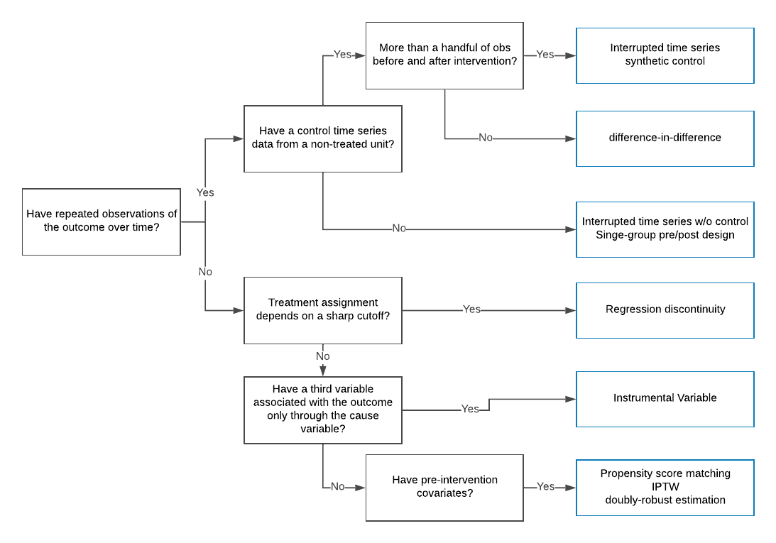
Source: https://eng.uber.com/causal-inference-at-uber/

Slide 32
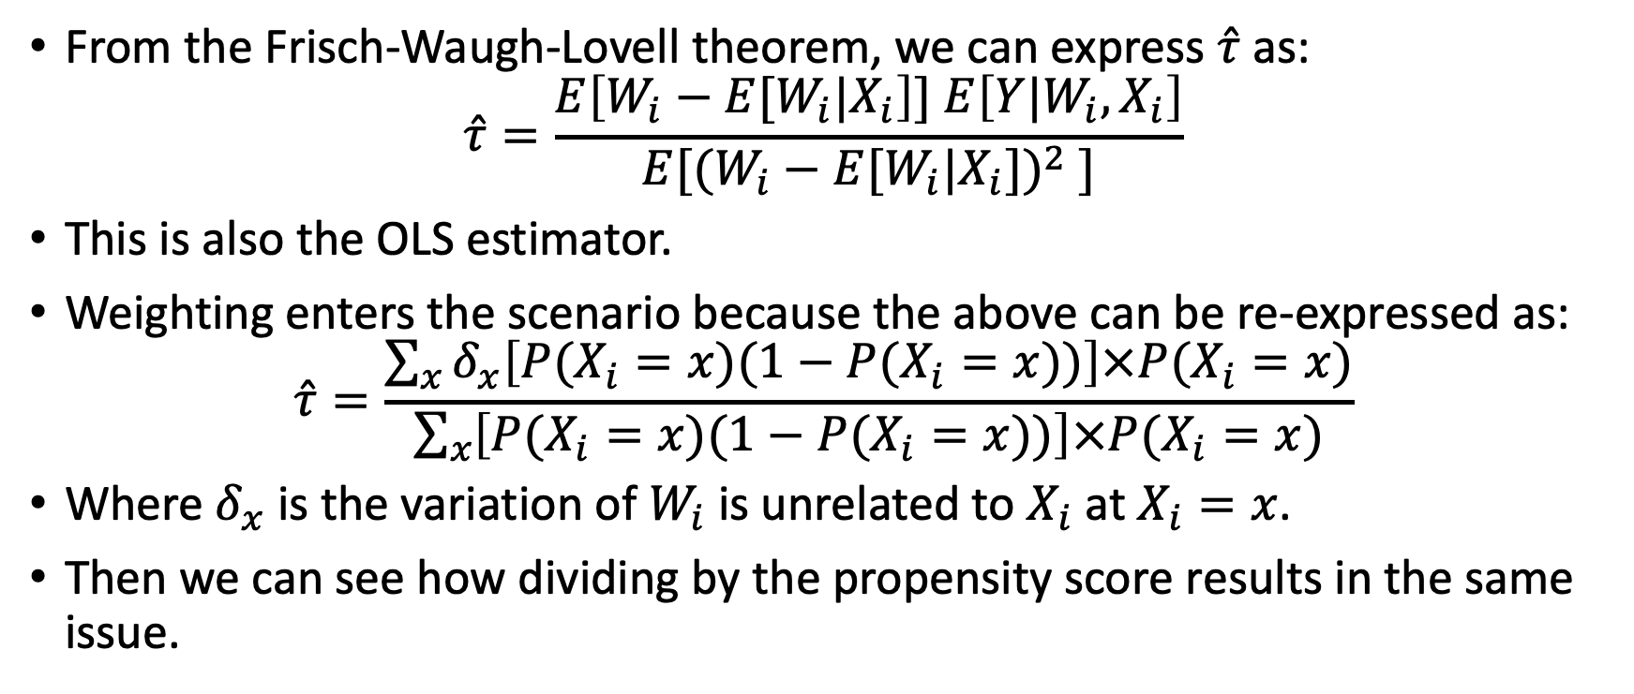
Weighting in OLS
From the Frisch-Waugh-Lovell theorem, we can express $\hat{τ}$ as:
$$\hat{τ}=\frac{E\left[W_{i}−E[W_{i}|X_{i}\right]] E\left[Y|W_{i}, X_{i}\right]}{E[{(W_{i}−E[W_{i}|X_{i}])}^{2} ]}$$
This is also the OLS estimator.
Weighting enters the scenario because the above can be re-expressed as:
$$\hat{τ}=\frac{\sum_{x}{δ_{x}\left[P(X_{i}=x)(1−P(X_{i}=x))\right]×P(X_{i}=x)}}{\sum_{x}{\left[P(X_{i}=x)(1−P(X_{i}=x))\right]×P(X_{i}=x)}}$$
Where $δ_{x}$ is the variation of $W_{i}$ is unrelated to $X_{i}$ at $X_{i}=x$.
Then we can see how dividing by the propensity score results in the same issue.

